Slide 1
CAPSTONE PROJECT – 2 NETWORKING WITH PYTHON
TEAM – 1
Sai Sruthilaya
Vyshnavi
Aditya
Supraja
Sai Swapna

Slide 2
USE CASES

Slide 3
Team Work
– Bandwidth, Router packet details, DB_Implementation, Code Integration.
– DB_implementation, Login page.
– Ping monitoring and writing the output to text file.
– Login page using Tkinter.

Slide 4
FloW CHART

Slide 5
DB IMPLEMENTATION
from tkinter import * from tkinter import messagebox import mysql.connector import os import time class DB_Access: def __init__(self): #connecting to the database self.db = mysql.connector.connect(host="localhost",user="root",password="admin",database="demo1") self.mycur = self.db.cursor() #destroy() in the code base is used to destroy the window def error_destroy(self): err.destroy() def succ_destroy(self): succ.destroy() root1.destroy()

Slide 6
#error message pop-up box design def error(self): global err err = Toplevel(root1) err.title("Error") err.geometry("200x100") Label(err,text="All fields are required..",fg="red",font="bold").pack() Label(err,text="").pack() Button(err,text="Ok",bg="grey",width=8,height=1,command=self.error_destroy).pack() #success message pop-up box design def success(self): global succ succ = Toplevel(root1) succ.title("Success") succ.geometry("200x100") Label(succ, text="Registration successful...", fg="green", font="bold").pack() Label(succ, text="").pack() Button(succ, text="Ok", bg="grey", width=8, height=1, command=self.succ_destroy).pack() def register_user(self): username_info = username.get() password_info = password.get() if username_info == "": error() elif password_info == "": error() else:

Slide 7
def registration(self): global root1 root1 = Toplevel(root) root1.title("Registration Portal") root1.geometry("300x250") global username global password Label(root1,text="Register your account",bg="grey",fg="black",font="bold",width=300).pack() username = StringVar() password = StringVar() Label(root1,text="").pack() Label(root1,text="Username :",font="bold").pack() Entry(root1,textvariable=username).pack() Label(root1, text="").pack() Label(root1, text="Password :").pack() Entry(root1, textvariable=password,show="*").pack() Label(root1, text="").pack() Button(root1,text="Register",bg="red",command=self.register_user).pack() def login(self): global root2 root2 = Toplevel(root) root2.title("Log-In Portal") root2.geometry("300x300") global username_varify global password_varify Label(root2, text="Log-In Portal", bg="grey", fg="black", font="bold",width=300).pack() username_varify = StringVar() password_varify = StringVar() Label(root2, text="").pack() Label(root2, text="Username :", font="bold").pack() Entry(root2, textvariable=username_varify).pack() Label(root2, text="").pack() Label(root2, text="Password :").pack() Entry(root2, textvariable=password_varify, show="*").pack() Label(root2, text="").pack() Button(root2, text="Log-In", bg="red",command=self.login_varify).pack() Label(root2, text="")

Slide 8
def logg_destroy(self): logg.destroy() root2.destroy() def fail_destroy(self): fail.destroy() def logged(self): global logg logg = Toplevel(root2) logg.title("Welcome") logg.geometry("200x100") Label(logg, text="Welcome {} ".format(username_varify.get()), fg="green", font="bold").pack() Label(logg, text="").pack() Button(logg, text="Log-Out", bg="grey", width=8, height=1, command=self.logg_destroy).pack() def failed(self): global fail fail = Toplevel(root2) fail.title("Invalid") fail.geometry("200x100") Label(fail, text="Invalid credentials...", fg="red", font="bold").pack() Label(fail, text="").pack() Button(fail, text="Ok", bg="grey", width=8, height=1, command=self.fail_destroy).pack()

Slide 9
def login_varify(self): user_varify = username_varify.get() pas_varify = password_varify.get() sql = "select * from login where user = %s and password = %s" self.mycur.execute(sql,[(user_varify),(pas_varify)]) results = self.mycur.fetchall() if results: for i in results: self.logged() break else: self.failed() def main_screen(self): global root root = Tk() root.title("Log-IN Portal") root.geometry("300x300") Label(root,text="Welcome to Log-In Protal",font="bold",bg="grey",fg="black",width=300).pack() Label(root,text="").pack() Button(root,text="Log-IN",width="8",height="1",bg="red",font="bold",command=self.login).pack() Label(root,text="").pack() Button(root, text="Registration",height="1",width="15",bg="red",font="bold",command=self.registration).pack() Label(root,text="").pack() Label(root,text="").pack() root.mainloop() DB = DB_Access() DB.main_screen()

Slide 10
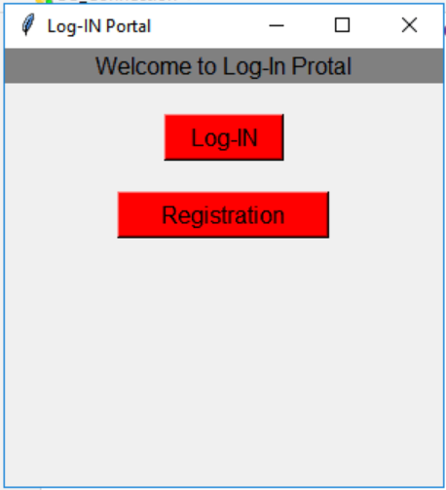
DB OUTPUT-1
(LOGIN PORTAL AND REGISTRATION PORTAL

Slide 11
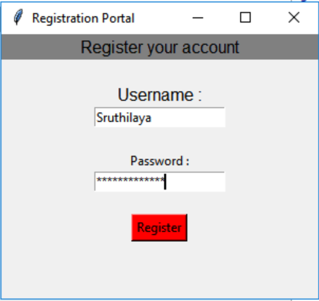
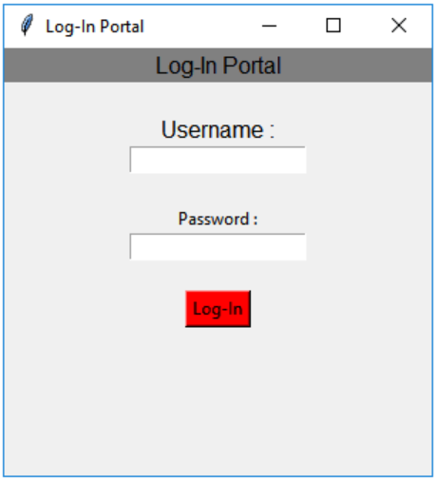
DB – REGISTRATION AND LOGIN PAGE

Slide 12
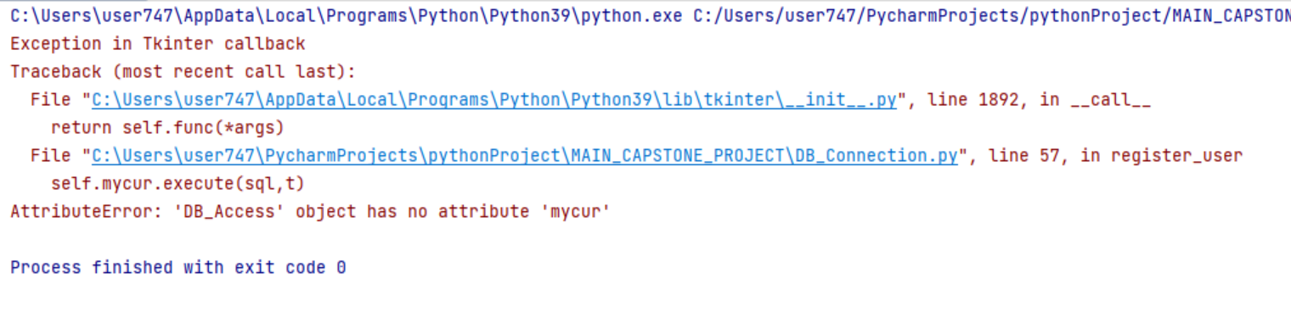
DB – OUTPUT-1
(SUCCESSFUL LOGIN SCREEN)
BUT GETTING ERROR

Slide 13
DB – OUTPUT-1
(ERROR SCREEN)

Slide 14
ROUTER PACKET DETAILS
import psutil from netmiko import ConnectHandler from threading import Thread class Router_Packet_details: def get_packet_details(): router = { "device_type":"cisco_ios", "ip":"sandbox-iosxe-latest-1.cisco.com", "username":"developer", "password":"C1sco12345" } net_connect = ConnectHandler(**router) network_stats = psutil.net_io_counters(pernic = False,nowrap = True) print(network_stats) bytes_sent = getattr(network_stats, 'bytes_sent') bytes_recv = getattr(network_stats,'bytes_recv') print("Bytes Sent = {0} | Bytes Received = {1}".format(bytes_sent,bytes_recv)) net_connect.disconnect() Route_details = Router_Packet_details Thread1 = Thread(target = Route_details.get_packet_details()) Thread2 = Thread(target = Route_details.get_packet_details()) Thread1.start() Thread2.start() Thread1.join() Thread2.join()

Slide 15
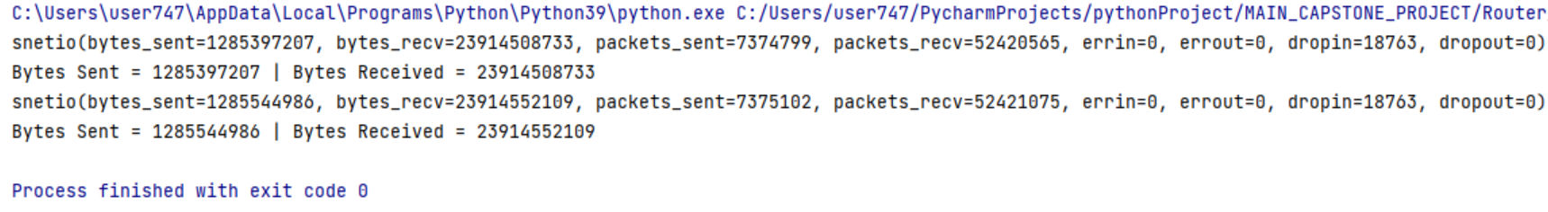
ROUTER PACKET DETAILS OUTPUT

Slide 16
Ping MONITORING
from netmiko import ConnectHandler import os class Ping_test: def __init__(self): ip = input("Enter an IP address or domain name to ping : ") # ping for each ip in the file response = os.popen(f"ping {ip} ").read() #saving some ping output details to output file if("Request timed out." or "unreachable") in response: print(response) f = open("ping_output.txt","a") f.write(str(ip) + ' link is down'+'\n') f.close()
else: print(response) f = open("ping_output.txt","a") f.write(str(ip) + ' is up '+'\n') f.close()
# print output file to screen with open("ping_output.txt") as file: output = file.read() f.close() print(output) Ping_test()

Slide 17
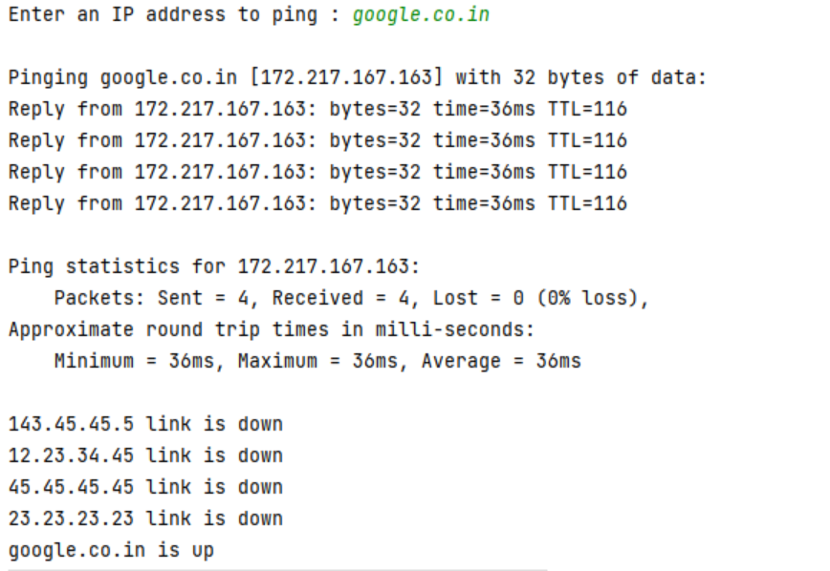
Ping output-1
Ping output-1

Slide 18
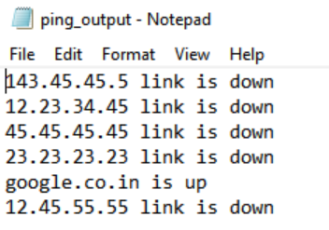
Ping output-2

Slide 19
BANDWIDTH
from scapy.all import * import psutil import os from threading import Thread import pandas as pd import time class Bandwidth: UPDATE_DELAY = 1 def get_size(bytes): for unit in ['','K','M','G','T','P']: if bytes < 1024: return f"{bytes:.2f}{unit}B" bytes /=1024 #used to get network input/output statistics in the form of a tuple io = psutil.net_io_counters(pernic = True)

Slide 20
while True: #time.sleep(UPDATE_DELAY) io_2 = psutil.net_io_counters(pernic = True) data = [] for iface, iface_io in io.items(): upload_speed, download_speed = io_2[iface].bytes_sent - iface_io.bytes_sent, io_2[iface].bytes_recv - iface_io.bytes_recv data.append({ "iface":iface, "Download": get_size(io_2[iface].bytes_recv), "upload" : get_size(io_2[iface].bytes_sent), "upload speed": f"{get_size(upload_speed / UPDATE_DELAY)}/s", "Download Speed":f"{get_size(download_speed/UPDATE_DELAY)}/S", }) io = io_2 df = pd.DataFrame(data) df.sort_values("Download", inplace = True, ascending = False) os.system("cls") if "nt" in os.name else os.system("clear") #to print output as console friendly tabular format print(df.to_string()) Get_Bandwidth = Bandwidth() Get_Bandwidth()

Slide 21
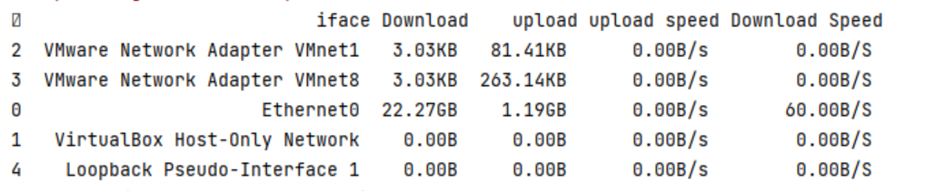
BANDWIDTH OUTPUT

Slide 22
FINDING PORT
from threading import Thread import socket host = str(input('host > ')) from_port = int(input('start scan from port > ')) to_port = int(input('finish scan to port > ')) counting_open = [] counting_close = [] threads = [] class Finding_unsedports: def scan(port): s = socket.socket() result = s.connect_ex((str(host),port)) #print(('checking ports > '+(str(port)))) if result == 0: counting_open.append(port) print((str(port))+' -> is open') peer = s.getpeername() print(peer) s.close()
else: counting_close.append(port) #print((str(port))+' -> is closed') s.close() for i in range(from_port, to_port+1): t = Thread(target=scan, args=(i,)) threads.append(t) t.start() [x.join() for x in threads] print(counting_open) Finding_unsedports()

Slide 23
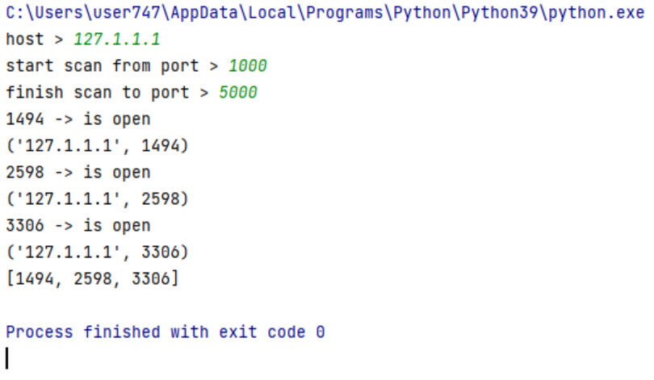
FINDING PORT

Slide 24
MODEL DRIVEN PROGRAMMABILITY
#MODEL DRIVEN PROGRAMMABILITY from ncclient import manager import re nexus = manager.connect( host='sandbox-iosxe-latest-1.cisco.com', username='developer', password='C1sco12345', allow_agent=False, look_for_keys=False, hostkey_verify=False, unknown_host_cb=True) for capability in nexus.server_capabilities: print (capability)

Slide 25
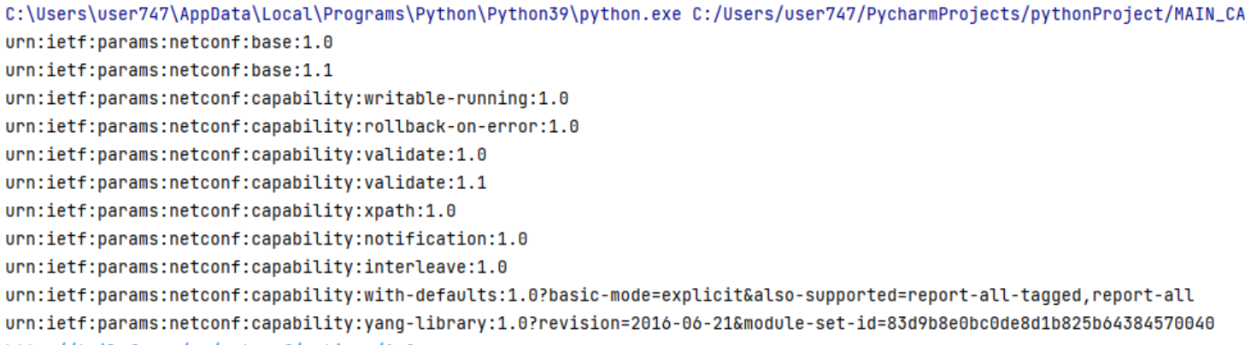
MODEL DRIVEN PROGRAMMABILITY

Slide 26
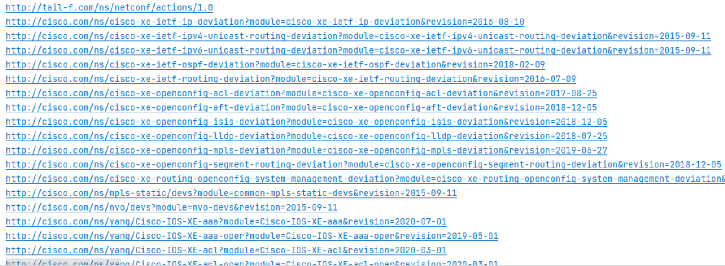
MODEL DRIVEN PROGRAMMABILITY

Slide 27
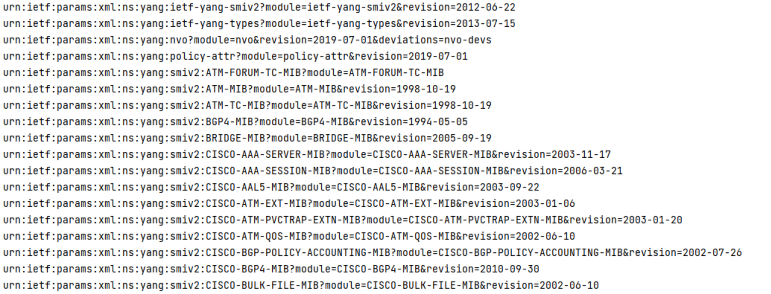
MODEL DRIVEN PROGRAMMABILITY

Slide 28
MAIN CODE (INTEGRATION)
import sys class Main: def run_db(self): import DB_connection def run_Router_Packet_Details(self): import Router_Packet_Details def run_Ping_monitoring(self): import Ping_monitoring def get_bandwidth(self): import Bandwidth def exitprogram(): sys.exit("system exiting") def printerror(): print("Invalid option entered") main = Main()

Slide 29
MAIN CODE (INTEGRATION)
def run(): menu={ 1:main.run_db, 2:main.run_Router_Packet_Details, 3:main.run_Ping_monitoring, 4:main.get_bandwidth, 5:exitprogram } while True: print("\n 1:Establish DataBase connection\n2:Get router packet details\n3:Ping Monitoring\n4:Get Bandwidth\n5:Exit Program\nEnter your choice?",end='') try : choice = int(input()) except ValueError: print("Please enter a valid input!") menu.get(choice,printerror)() run()

Slide 30
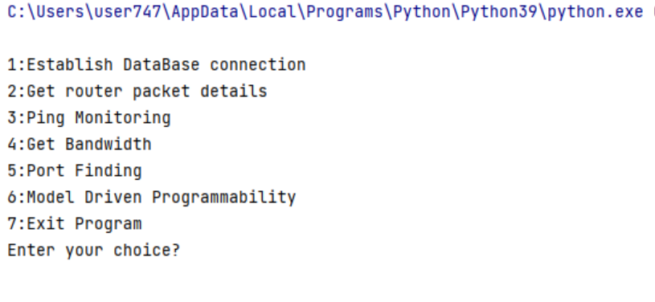
MAIN CODE (INTEGRATION)

Slide 31
THANK YOUUUUU

